Slide 1
Pre-Pregnancy Counseling:
It Takes A Village
David Hack, MD
St. Francis Tiny Steps

Slide 2
DISCLOSURE
I have nothing to disclose.

Slide 3
LEARNING OBJECTIVES
What is the scope of the problem in Delaware and how can preconception care help?
The basic topics of preconception care and how to work them into your daily practice.
What are some resources that can be used in preconception care?
Notes:
Improve attitudes, behaviors and knowledge
Assure all women of childbearing age in the US receive preconception care services in some form
Reduce risks of previous poor pregnancy outcomes
Reduce disparities in adverse pregnancy outcomes

Slide 4
PRE-TEST QUESTIONS
Please answer these polling questions.

Slide 5
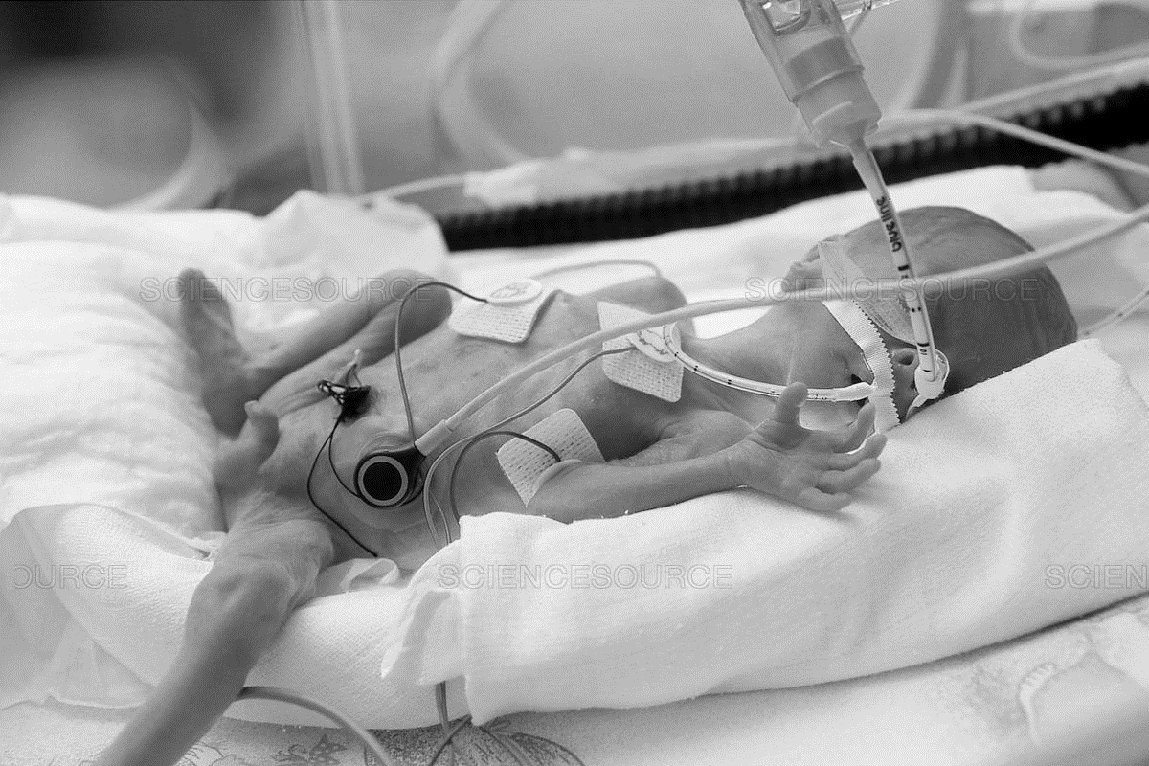
DELAWARE PREMATURE RATE
10.7% DELAWARE
PRETERM RATE
March of Dimes Report Card, 2019
Notes:
CDC 2013 data collection (14th in the US) 11.4 in the US vs. 12.4% in Delaware

Slide 6
STATE REPORT CARD
9.4%
9.0%
9.5%
10.7%
National Center for Health Statistics 2017
Notes:
Compares 2017 preterm birth rate in the state to the March of Dimes goal of 8.1% by 2020
(Preterm birth rate in the state – 8.1)/standard deviation of the final 2014 state rates
Provides county and race/ethnicity data to take into account equity among the populations in a state

Slide 7
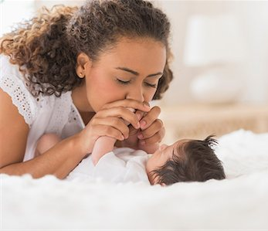
DISPARITY IN THE STATE
Black infants: 12.1%
Hispanic infants: 8.7%
March of Dimes Report Card, 2018
Notes:
Whites 10.7%, Asians 11.4%

Slide 8
DELAWARE DISPARITY RATIO

Slide 9
BORN TOO SOON
Born Too Soon-WHO
Single most important cause of death in children <28 days
5th leading cause of death in children under 5 years old
54th in the world

Slide 10
CONCEPTS OF PRECONCEPTION CARE VISIT
40-50% of pregnancies are unplanned
20% of women report any education
Little research addressing outcome
Only 36% of women with Medicaid had it before pregnancy
Health Services Research Feb 2008
Notes:
Cochrane data base did not find any evidence to support routine advice, counseling, and possibly screening tests that improved pregnancy outcomes (OCT 2007). This involved only 2300 women in 4 trials and only one trial followed women through to pregnancy.
Little research – fragmentation of health care and lack of universal healthcare with overall coordination of care

Slide 11
ONE KEY QUESTION
Would you like to become pregnant in the next year?

Slide 12
EDUCATION FOR PRECONCEPTION
MY LIFE MY PLAN
www.dethrives.com/mlmpw/overview
BEFORE PREGNANCY
www.cdc.gov/preconception/planning.html
IMPLICIT TOOLKIT
https://www.marchofdimes.org/professionals/implicit-interconception-care-toolkit.aspx

Slide 13
FAMILY PLANNING AND SPACING
INFECTIONS
IMMUNIZATION
SUBSTANCE ABUSE
CHRONIC MEDICAL PROBLEMS
DOMESTIC VIOLENCE
REVIEW MEDICATION
FAMILY HISTORY
OCCUPATION EXPOSURE
NUTRITION AND DIET

Slide 14
FAMILY PLANNING AND SPACING
Advise women to avoid interpregnancy spacing less than 6 months
Counsel about risks/benefits to interpregnancy spacing less than 18 months
Begin discussion during prenatal care
Continue discussion postpartum
Use Pediatric Well Visits to reinforce and screen
IMPLICIT toolkit

Slide 15
REVIEW OF MEDICAL HISTORY
Pre-gestational Diabetes | Congenital abnormalities
Chronic Hypertension | Preeclampsia and IUGR
Hypothyroidism | miscarriage, preterm birth, preeclampsia,
Bariatric surgery | Fetal growth
Mood disorders | Bonding difficulty, neglect
Thrombophilia | DVT or PE
Notes:
DM: congenital anomalies, pregnancy related complications (HgA1C <6.5, euglycemic control, optimal weight management, retinal exam, TSH screen, 24 hour urine protein)
Chronic HTN: preeclampsia and IUGR (assess meds, ventricular hypertrophy and retinopathy and nephropathy in longstanding uncontrolled)
Hpothyroidism: spontaneous AB, preeclampsia, preterm birth, placental abruption, fetal death (screening on risk factors)
Bariatric Sx: postoperative 12-24 month high risk with high weight loss and fetal growth
Mood disorders: impaired maternal infant bonding, risk of maternal self-harm, assess medications
Thrombophilia: DVT or PE

Slide 16
REVIEW CURRENT MEDICATIONS
Prescription Medication
Nonprescription Medication
Nutritional supplementation
Herbal Products
Achieve safest medication profile
Optimal effectiveness to lowest teratogenic potential
Herbal products NOT required to be tested for safety
Educate women to NOT stop prescription drugs without consult

Slide 17
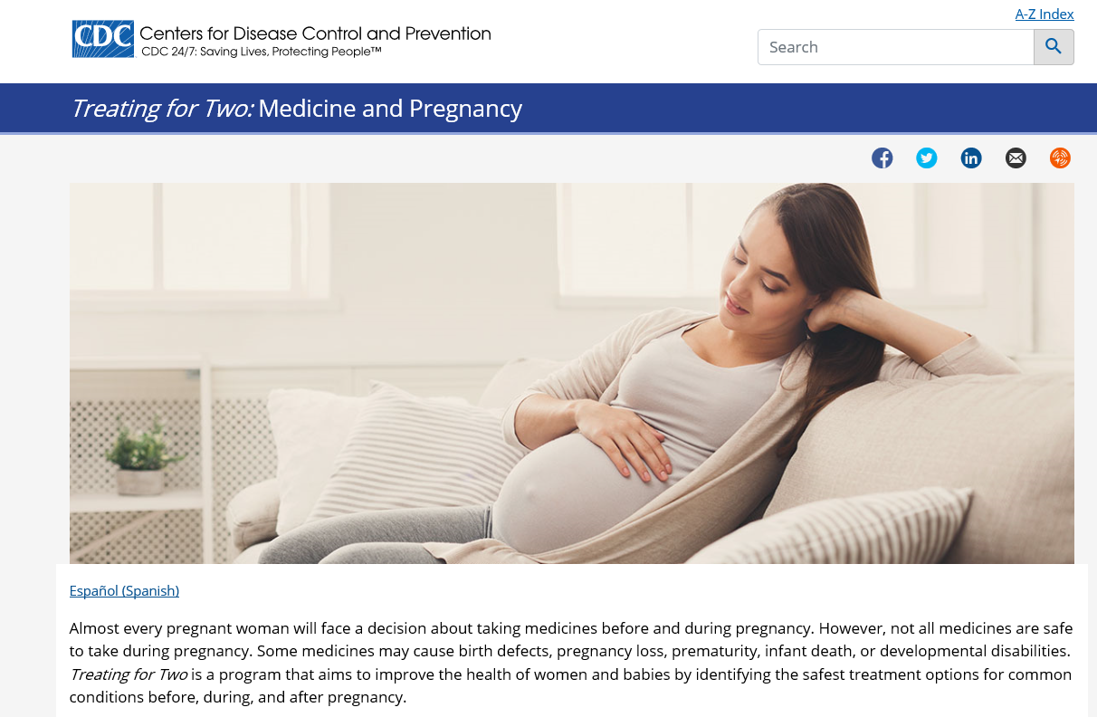
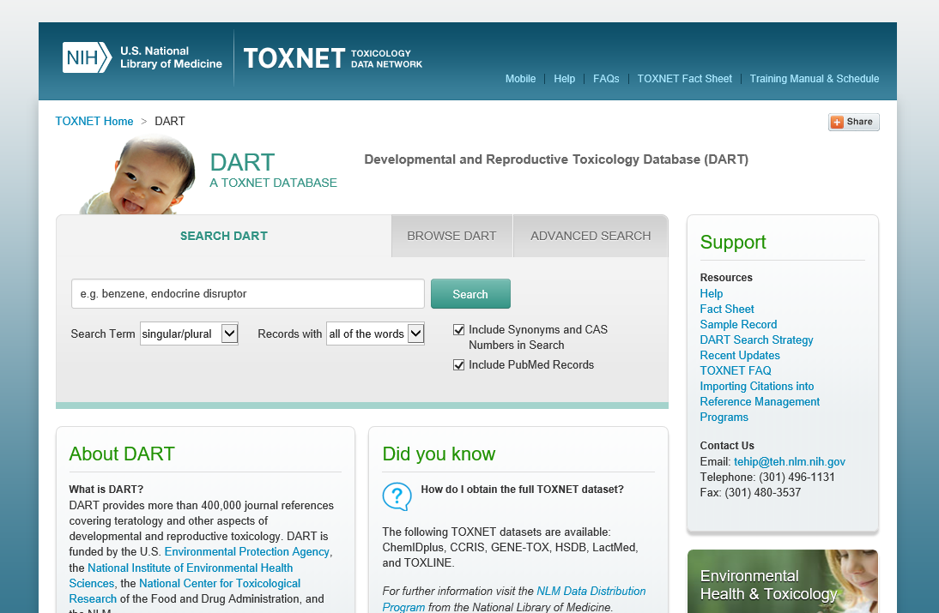
CURRENT MEDICATION RESOURCES
Notes:
LACTMED in the same DART website

Slide 18
PRESCRIPTION MEDICATIONS
ACE inhibitors
SSRI medications
Warfarin
Pain medications
Anti-seizure medications

Slide 19
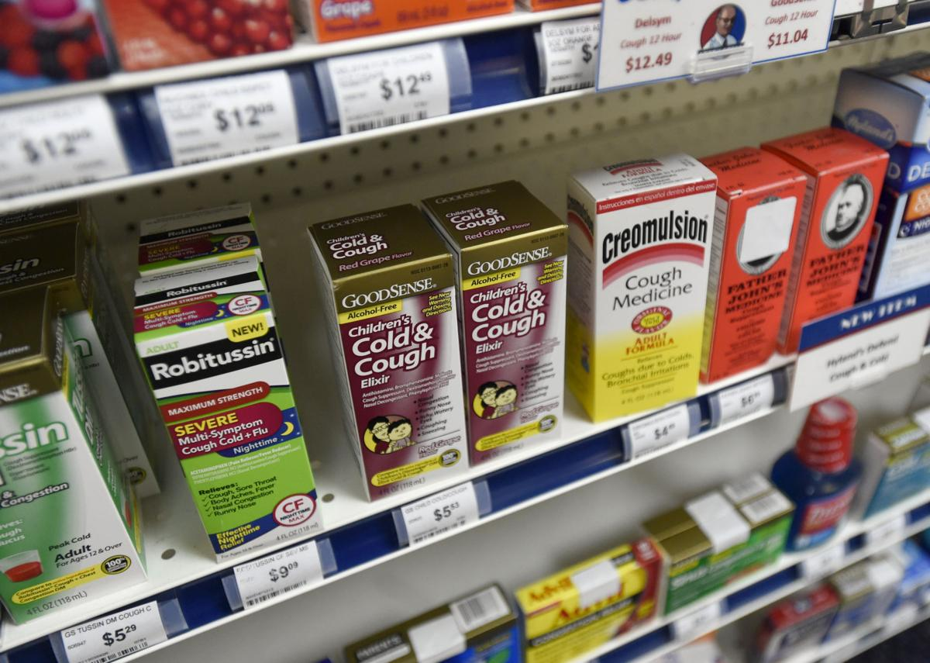
NONPRESCRIPTION MEDICATIONS
Analgesic medications
Cough and cold medications
Symptomatic GI treatments
Sleep aids

Slide 20
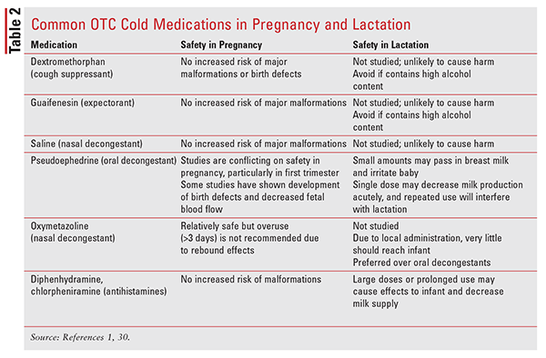
NONPRESCRIPTION MEDICATIONS
US Pharmacist, September 2019

Slide 21
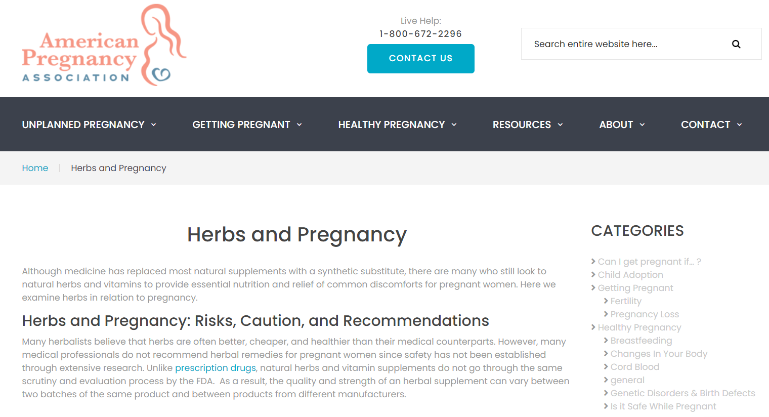
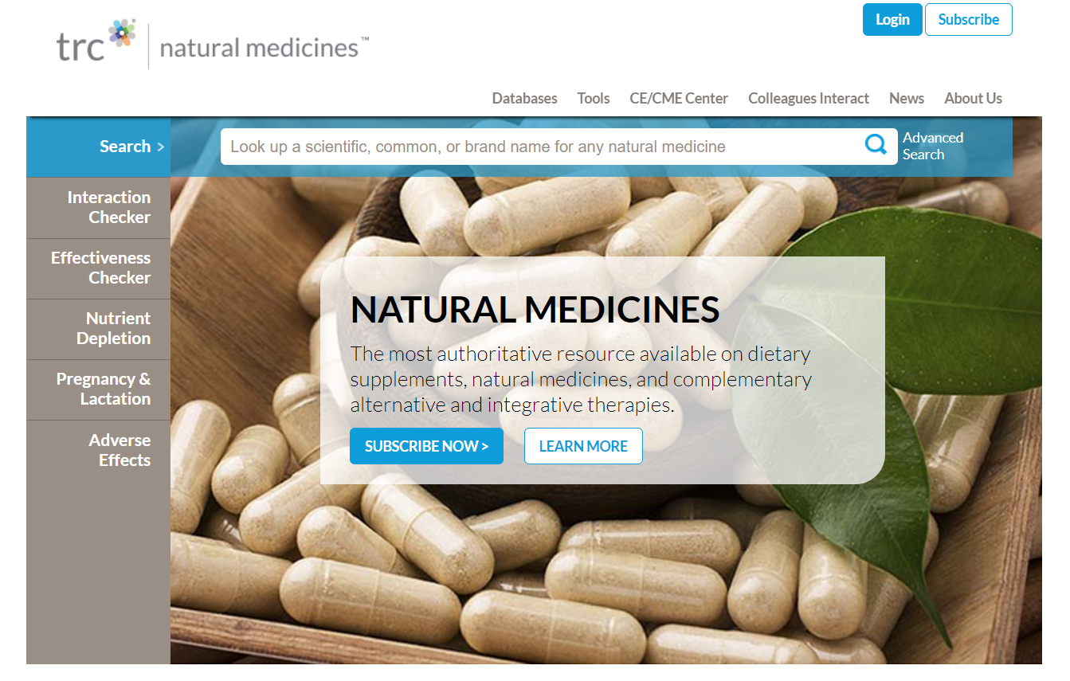
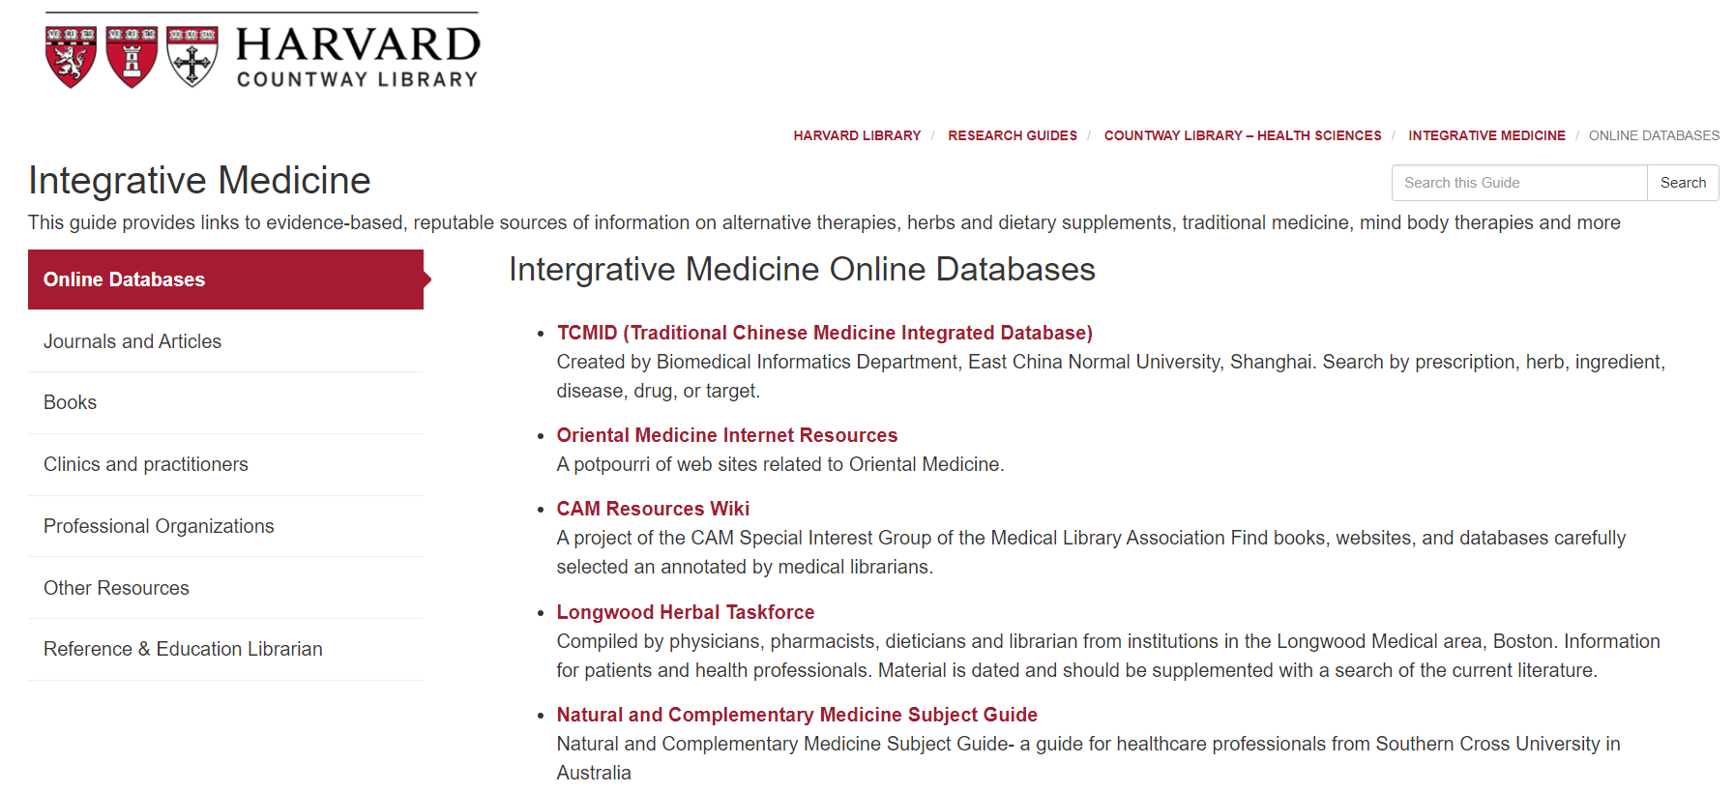
HERBAL AND VITAMIN SUPPLEMENTS
Notes:
https://americanpregnancy.org/pregnancy-health/herbs-and-pregnancy/
Endorsed by the Journal of the medical library association (2004) – Therapeutic Research Faculty (TRC)

Slide 22
HERBAL AND VITAMIN SUPPLEMENTS
Echinacea
Goldenseal
Dong Quai
Yohimbe
Notes:
https://americanpregnancy.org/pregnancy-health/herbs-and-pregnancy/
Endorsed by the Journal of the medical library association (2004) – Therapeutic Research Faculty (TRC)
Echinacea: Jama 2000, Archives of Internal Medicine 2000,
Emmenagogues: herbal medicines capable of stimulating menstrual flow (Dong Quai)

Slide 23
REVIEW FAMILY AND GENETIC HISTORY
Pre-pregnancy and pregnancy screening offered the same
Pre-pregnancy and pregnancy screening paid by insurance differently
Formal genetic counseling
Preimplantation genetic testing

Slide 24
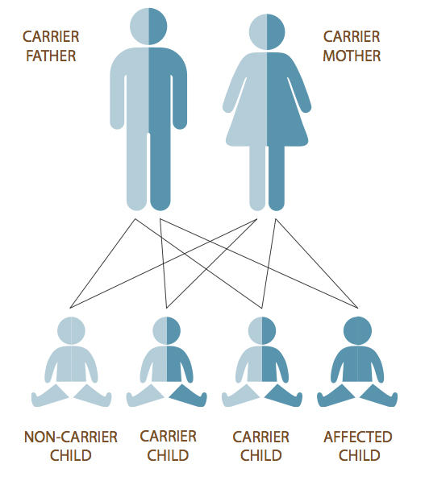
REVIEW FAMILY AND GENETIC HISTORY
Cystic Fibrosis
Fragile X
Hemoglobinopathies
Spinal muscular atrophy
Trisomy chromosomes
Tay-Sachs disease

Slide 25
IMMUNIZATIONS
No evidence exists of risk to infant from vaccination with INACTIVATED virus, BACTERIAL vaccines, or TOXOIDS
Due to theoretical risk, LIVE ATTENUATED vaccines and LIVE BACTERIAL vaccines are generally contraindicated
CDC: Pregnancy and vaccinations (last updated 2016)
Notes:
Influenza: every woman before and after pregnancy
Tdap: every woman, every pregnancy (27-36 weeks to maximize passive antibody but anytime during pregnancy);
MMR: not a reason for termination. Not within 28 days of theoretically becoming pregnant
VARICELLA: not within 28 days of becoming pregnant, having a pregnant household member NOT a reason to avoid vaccination

Slide 26
IMMUNIZATIONS
INFLUENZA (inactivated vs LAIV)
TDAP vs TD
MMR
VARICELLA
Notes:
Influenza: every woman before and after pregnancy
Tdap: every woman, every pregnancy (27-36 weeks to maximize passive antibody but anytime during pregnancy);
MMR: not a reason for termination. Not within 28 days of theoretically becoming pregnant
VARICELLA: not within 28 days of becoming pregnant, having a pregnant household member NOT a reason to avoid vaccination

Slide 27
IMMUNIZATIONS
INFLUENZA (inactivated vs LAIV)
HEPATITIS B
MMR
VARICELLA
HPV
PNEUMOCOCCAL
TD and TDAP
Notes:
Influenza: every woman before and after pregnancy
Tdap: every 10 years,
MMR: not a reason for termination. Not within 28 days of theoretically becoming pregnant
VARICELLA: not within 28 days of becoming pregnant, having a pregnant household member NOT a reason to avoid vaccination
HPV: hold of series if becomes pregnant
PNEUMOCCOCAL: 19 thru 64 with chronic heart (excluding HTN), lung or liver disease and diabetes and alcoholism and cigarette smoking. Immunocompromising conditions, CSF leak or cochlear implant.

Slide 28
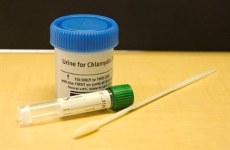
INFECTIOUS DISEASE SCREENING
Chlamydia
Gonorrhea
Hepatitis B
Hepatitis C
HIV

Slide 29
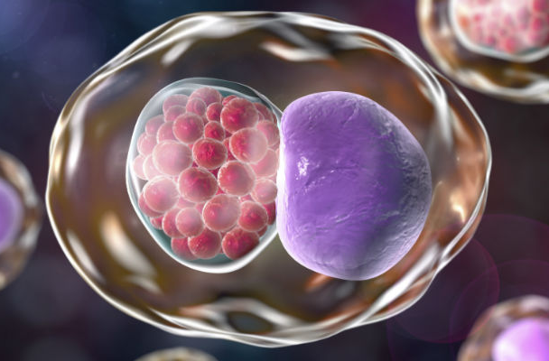
CHLAMYDIA AND GONORRHEA SCREENING
Women 24 and younger who are sexually active (B)
Older women at increased risk (B)
Insufficient evidence for screening in men (I)
United States Preventative Task Force current recommendations
Notes:
AGE is strong risk factor (20-24 women) followed by females 15 to 19
OTHER RISK: new sex partner, more than 1 sex partner, a sex partner who has concurrent partners, inconsistent condom use not in monogamous relationship, previous or coexisting STI, exchanging sex for money or drugs.
RACE: Black and Hispanic higher rates than whites (2012)
Consider risk in your community or geographic area

Slide 30
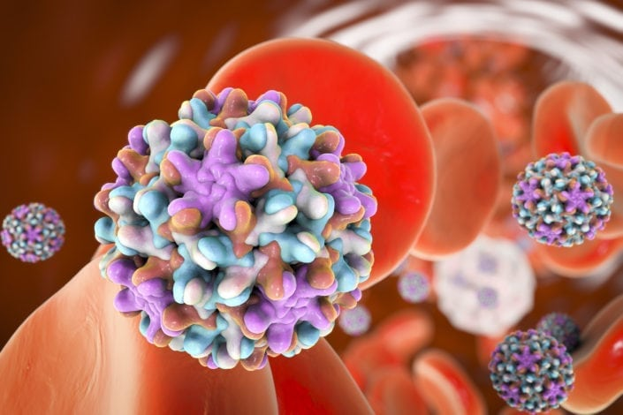
HEPATITIS B SCREENING
Injection drug users
Men who have sex with men
Elevated ALT/AST
Household contacts and sexual contacts with known carriers
People with HIV
Pregnant women
Exposure to blood with hepatitis B
CDC September 2008 current recommendations

Slide 31
HEPATITIS C SCREENING
Intranasal cocaine or other illegal substance
History of tattooing or body piercing
History of multiple sex partners or STI
Long term hepatitis C partner
Born 1945 to 1965
Ever injected drugs
Received blood, blood components, or organ transplant before July 1992
Hemodialysis long-term
HIV infected
Persistent elevated ALT
Exposure to Hepatitis C blood
CDC MMWR 2012 current recommendations

Slide 32
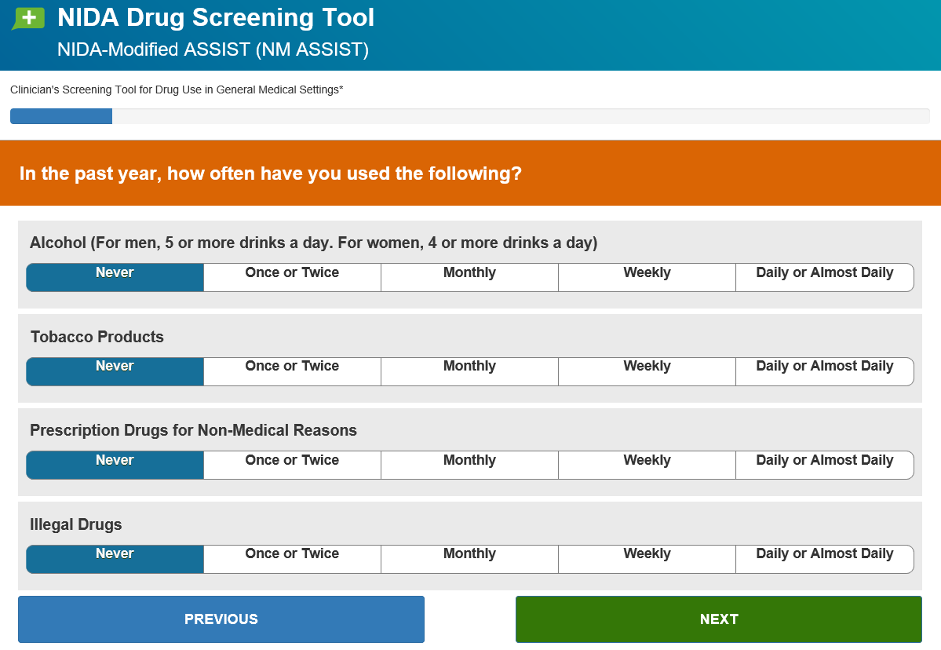
SUBSTANCE ABUSE ASSESSMENT
NIDA Quick Screen
4 or more alcohol drinks a day
Tobacco products
Prescription drugs for Non-Medical reasons
Illegal Drugs

Slide 33
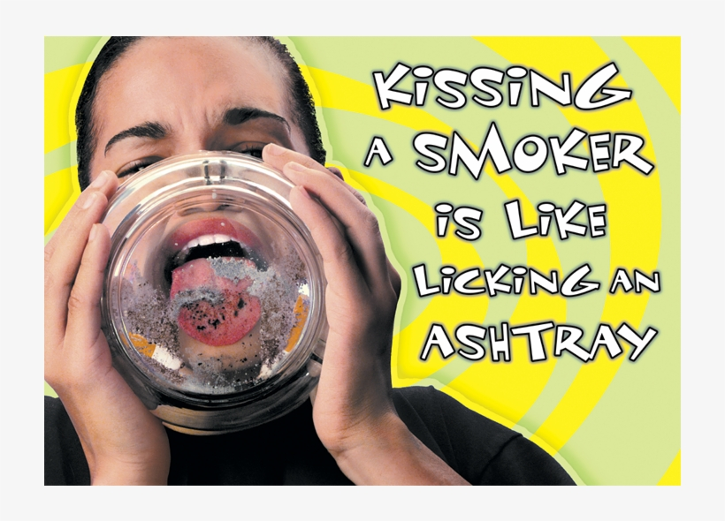
TOBACCO PRODUCTS
Adverse pregnancy outcomes:
IUGR
Placenta Previa
Abruptio placentae
PPROM
Low birth weight
Perinatal mortality
Ectopic pregnancy
Adverse childhood risk:
Asthma
Infantile colic
Childhood obesity
SIDS
5 A’s of Smoking Cessation
ASK about status
ADVISE about risk/to stop
ASSESS willingness to quit
ASSIST those ready to quit
ARRANGE follow up visits

Slide 34
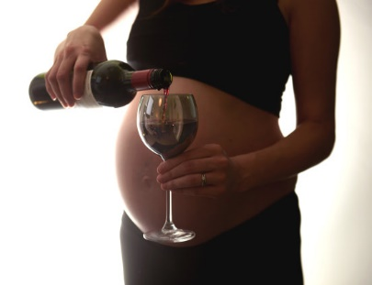
ALCOHOL USE
Fetal Alcohol Spectrum Disorder
Affect fetus at any stage
Facial dysmorphia
Growth defects
CNS abnormalities
Lifelong affects for the newborn
Notes:
Facial dysmorphia: Smooth philtrum between nose and upper lip, small head size
Growth defects: shorter than average height, low body weight
CNS abnormalities: hyperactivity, decreased attention, poor memory, difficulty in school, speech and language delays, low IQ

Slide 35
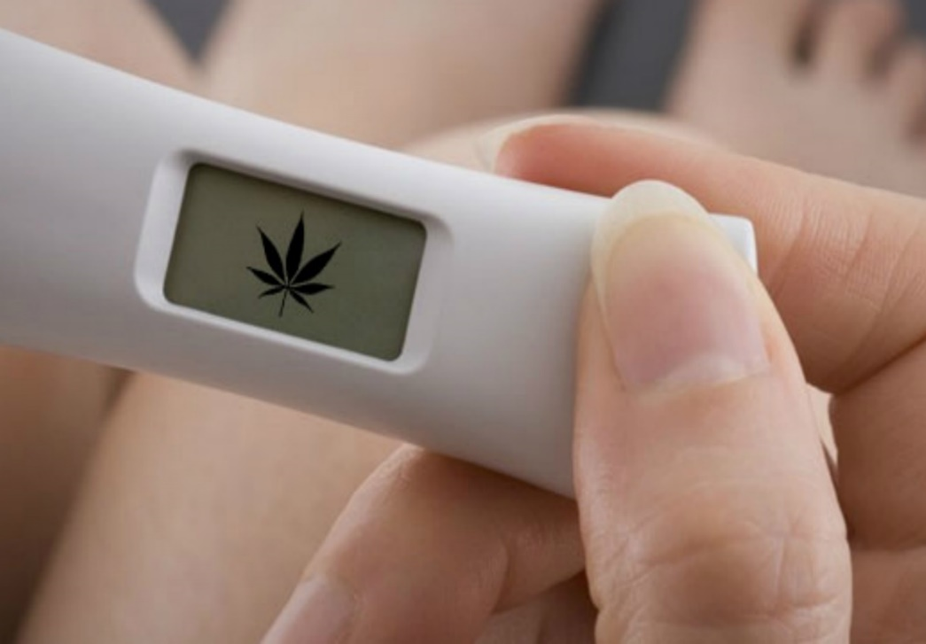
MARIJUANA USE
2-5% of pregnancies
Legalized in several states
Chemicals in any form can be bad for your baby
Breast feeding affects

Slide 36
VIOLENCE AND INTIMATE PARTNER VIOLENCE
1 in 3 women experience partner violence
Begin discussion framing the context that all women are screened
Mandated to report gun shots, poisonings or stabbings
Delaware Code Title 24: Chapter 17: Section 1762
www.dcdav.org/domestic-violence/

Slide 37
ASSESS NUTRITIONAL STATUS
Folic Acid (400mcgm/day)
Caffeine consumption
Fish and mercury
Listeria infections
Eating disorders
Bariatric surgery and malabsorptive disease

Slide 38
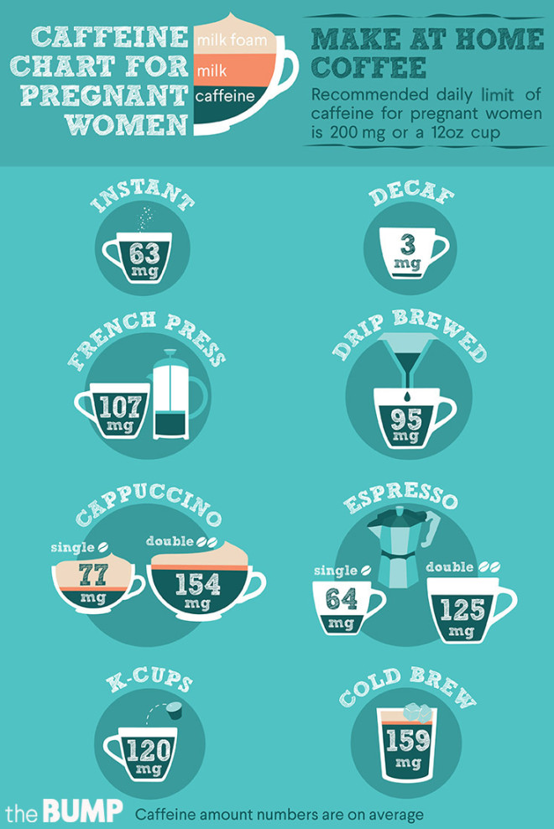
ASSESS NUTRITIONAL STATUS
Folic Acid (400mcgm/day)
Caffeine consumption
Fish and mercury
Listeria infections
Eating disorders
Bariatric surgery and malabsorptive disease

Slide 39
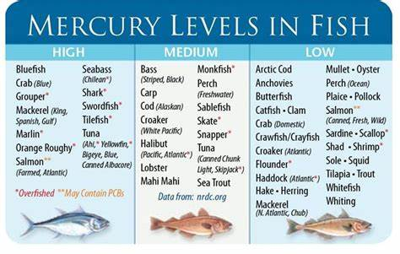
ASSESS NUTRITIONAL STATUS
Folic Acid (400mcgm/day)
Caffeine consumption
Fish and mercury
Listeria infections
Eating disorders
Bariatric surgery and malabsorptive disease

Slide 40
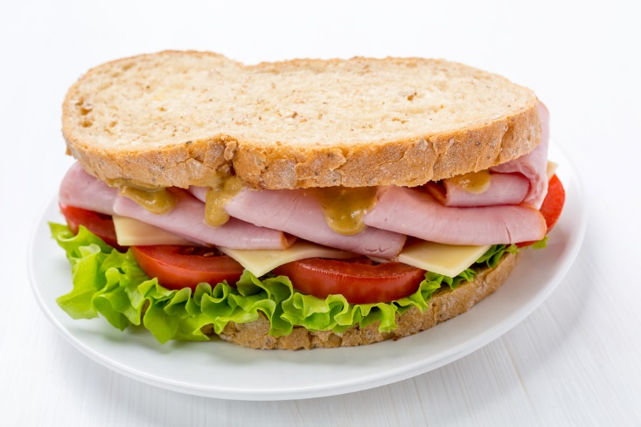
ASSESS NUTRITIONAL STATUS
Folic Acid (400mcgm/day)
Caffeine consumption
Fish and mercury
Listeria infections
Eating disorders
Bariatric surgery and malabsorptive disease

Slide 41
ASSESS NUTRITIONAL STATUS
Folic Acid (400mcgm/day)
Caffeine consumption
Fish and mercury
Listeria infections
Eating disorders
1 (800) 931-2237
National Eating Disorders Association

Slide 42
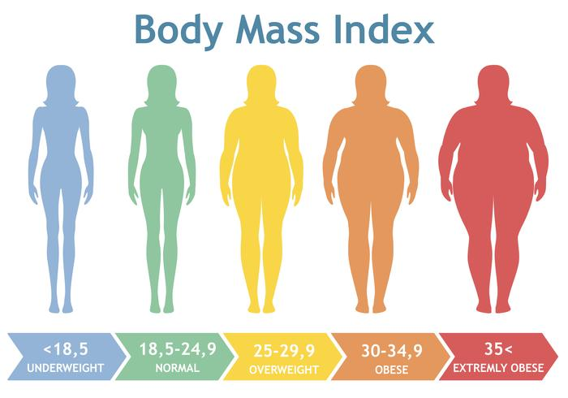
HEALTHY BODY WEIGHT
Reproductive Risks low BMI
Small for gestational age
Low birth weight
Reproductive Risks high BMI
Infertility
Miscarriage
Birth defects
Preterm delivery
Gestational diabetes
Gestational hypertension
Cesarean delivery
Thromboembolic events

Slide 43
OCCUPATIONAL/ENVIRONMENTAL EXPOSURE
Home risks
bisphenol-A
Pesticides
Lead
Asbestos
Work risks
Agriculture (pesticides)
Manufacturing (solvents and heavy metals)
Dry cleaning (solvents)
Health Care (biologics and radiation)

Slide 44
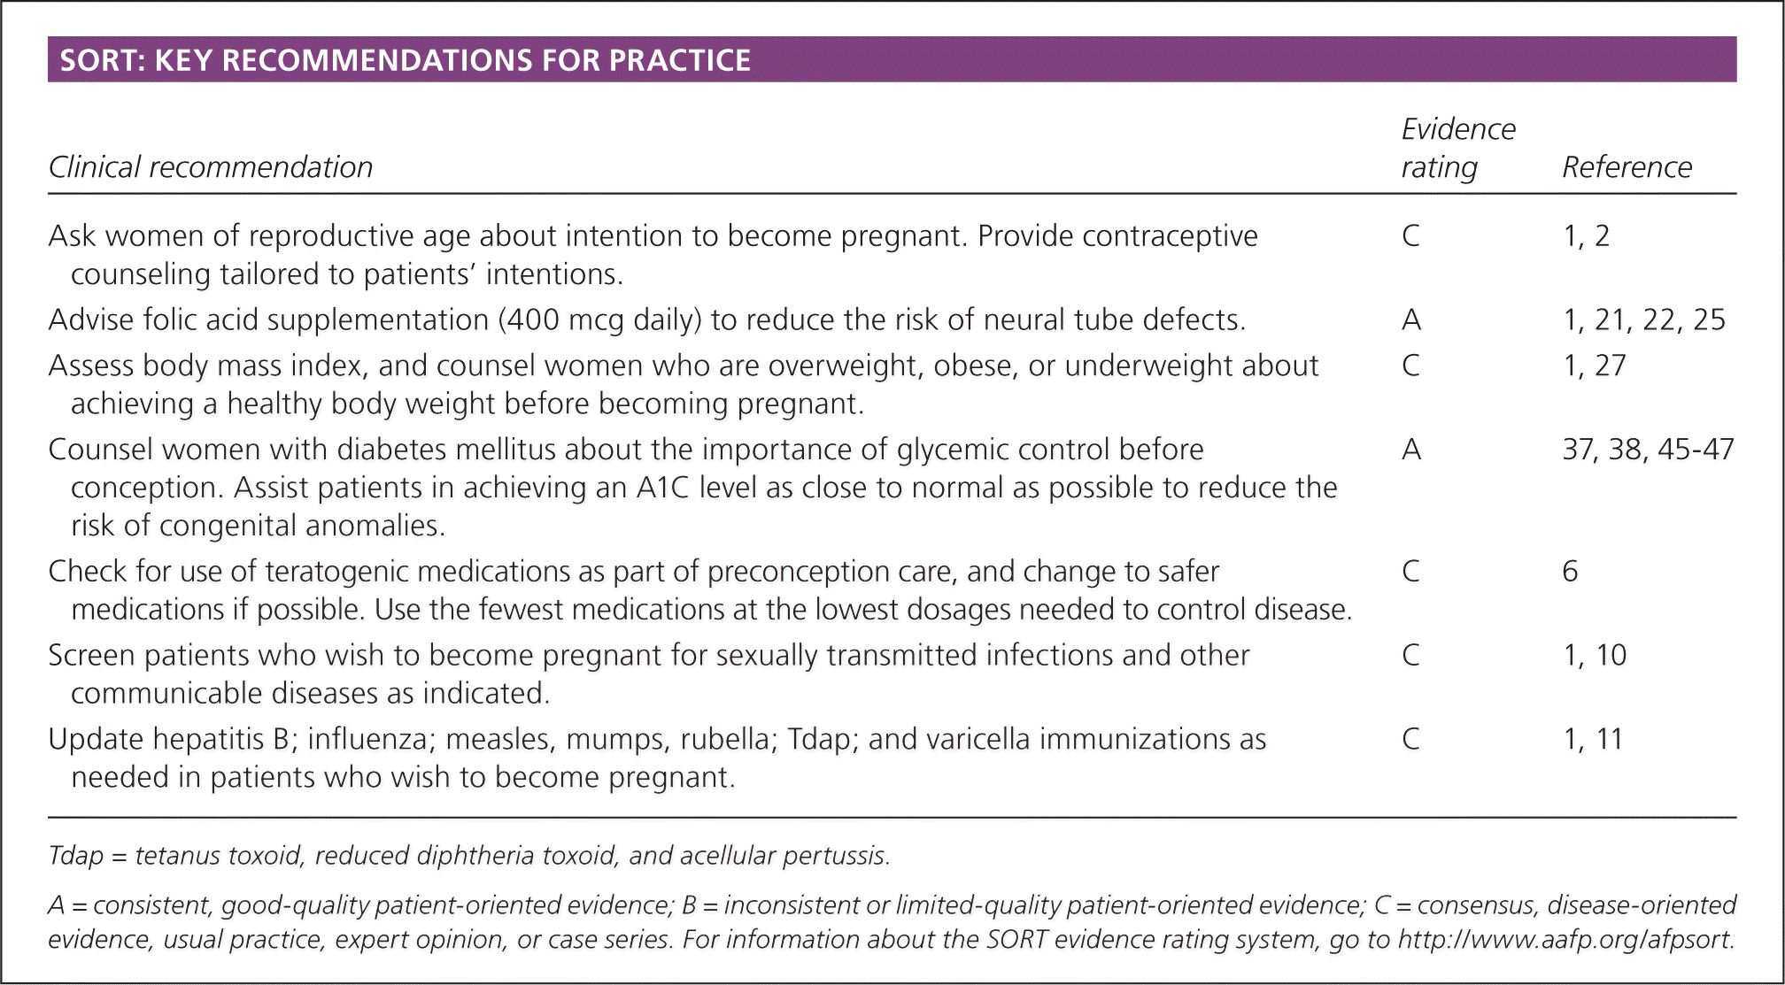

Slide 45
POST-TEST QUESTIONS
Please answer these polling questions.

Slide 46
Q A
&
Use the Chat feature located either at the upper or lower portion of your screen.

Slide 47
Thank you
DAVID HACK, MD
Dhack@CHE-EAST.org

