Slide 1
DMOST: New tool in Advance Care Planning
John Goodill, M.D.
9/1/16

Slide 2
OBJECTIVES
Update on Advance Care Planning and introduce DMOST
Show evidence for effectiveness of DMOST tool
Through cases, illustrate the creation and use of DMOST in the health care system.

Slide 3
Notes:
Americans are living longer but with a higher burden of illness and decreased QOL
-> 10 million older 85 in 2020
-> 10 million living with 4 or more chronic diseases by 2030
Two recent publications, IOM report Dying in America and NYT best seller BEING MORTAL by Atul Gawande, both highlight the problems we all face trying to navigate the final phase of our lives.
These include increased isolation, loss of meaning and function, increased burden of illness and symptoms and decreased mental capacity that illness brings.
There is certainly room for improvement in how we live the final chapters of our lives as was so clearly outlined in the IOM report from sept 2014.

Slide 4
5 Recommendations
Person-centered, family-oriented (palliative) care
Clinician-patient communication and ADVANCE CARE PLANNING
Professional education and development
Policies and payment systems
Public education and engagement

Slide 5
Advance Care Planning
A PROCESS of communication between patient, family, health care proxy and staff for the purposes of prospectively identifying a surrogate, clarifying treatment preferences and developing individualized goals of care across the lifespan
Notes:
ACP involves Conversations/communications that change with circumstances over the lifespan of an individual.
It Starts with an AD in adulthood laying out general values and identifying a POA.
It includes that identified POA in the process so that if/when that POA needs to be a surrogate decision maker they are prepared to do so.
ACP involves clarifying GOC/Treatment options as one deals with a serious illness.
ACP Can evolve to a DMOST to direct medical care in the final chapter of one’s life.

Slide 6
Mr. Hernandez
76 years old
Presented with abdominal discomfort 3 months ago and diagnosed with pancreatic cancer metastatic to liver
Patient at the Helen F. Graham Center
On palliative chemotherapy
He lives with his wife Brenda and has two adult daughters that live nearby

Slide 7
Mrs. Clarkson
87 years old
History of CAD, CHF, stroke 3 years ago that left her with left sided weakness, dementia
Resident of a nursing facility, bed to chair most days, frequent UTIs, needs assistance with all ADLs.
Has a daughter Brenda who lives nearby and is her POA for healthcare.

Slide 8
Advance Directives
‘Living will’/Durable power of attorney for health care
Improved but limitations persist
< 1/3 population have one
Often not created with fully informed understanding by all relevant persons/parties
Difficult to apply to specific situation
Notes:
AD have been around for 40 years but have not had great impact on directing the care people receive near the end of life for a number of reasons.
Our health care system has never made them a priority often looking at them with skepticism and distrust. Not engaging in making them so they could be more useful.
Few adults have them. Estimates of between 20-30%. We shy away from the difficult conversations needed to make a good one. Many of us are concerned they may work against usin the time of need and cause beneficial treatment to be withheld
Many have been crafted with a legal professional using the language of a legal statute which makes them difficult to apply to medical decision making at the bedside

Slide 9
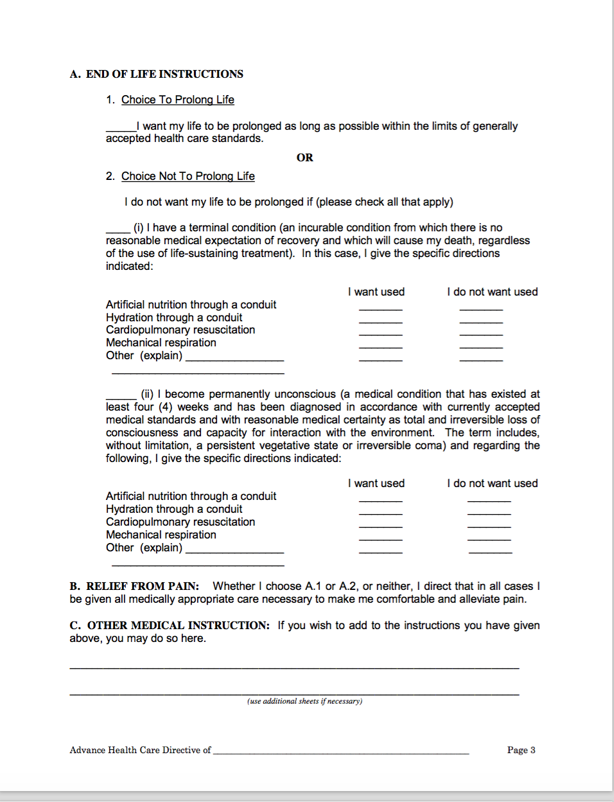
Notes:
Example of a page in the delaware health care directive form
Where would patient with dementia/anoxic brain injury/frailty or old age fit in here?
What about patient with exacerbation of advanced organ disease?

Slide 10
Enter DMOST (POLST, MOLST)
New tool for ACP near end of life
Voluntary
Aimed at persons ‘whose health care provider would not be surprised if they died in next year’
Standardized medical orders
Actionable
portable

Slide 11
DMOST – What, and When
DMOST is a clinical process to facilitate communication between health-care professionals and persons living with serious illness or frailty. The form documents the decisions made by the patient during the shared decision-making conversation and is signed by the health-care practitioner.
The DMOST conversation is to occur when the person’s health-care practitioner “would not be surprised if they died within the next year”.
§ 2503A(c)
Notes:
SCD: This slide is unnecessary if you use the one I have created comparing AHCD’s and DMOST.
2503A. Definitions.
(a) "Advance health-care directive" means an advance health-care directive under Chapter 25 of this title, a durable power of attorney for health-care decisions, or any individual instruction or power of attorney for health care valid in the state where such document was executed or where the individual executing such document was a resident at the time that such document was executed that appoints an agent. Said document must have been executed by the individual authorizing the appointed agent to make decisions about the individual's health care when such individual no longer has decision-making capacity.
Narrative: to reiterate, DMOST is a clinical process …

Slide 12
ADVANTAGES OF DMOST:
Clear, standardized instructions
Portable, follows pts thru transitions of care
Translates pts’ AD into an Actionable Medical Order
Can be initiated by surrogate and provider after patient has lost capacity and changed with changing circumstances

Slide 14
How Advance Directives and POLST Work Together
Adapted with permission from California POLST Education Program © January 2010 Coalition for Compassionate Care of California
Age 18
Complete and Advance Directive
Update Advance Directive Periodically
Diagnosed with Advanced Illness or Frailty(at any age)
Complete a POLST Form
Change in health status
May Complete a new POLST Form
Treatment Wishes Honored
Notes:
This diagragm shows how DMOST would work with the traditional AD:
You have an AD for all adults. This usually occurs when you are healthy and addresses question like -What makes my life worth living? What would I be willing to go through to survive?
Your AD names a POA that would be familiar to your answers to those questions.
POLST/DMOST is for seriously ill persons in last year of their life. Takes effect immediately. Can be changed if decisions/orders change

Slide 15
National
The first POLST (Physician Orders for Life Sustaining Treatment) program was launched in Oregon in 1991.
Collectively, the ethical framework and practice model guiding the development was called the POLST Paradigm.
Hence, the National POLST Paradigm also started in 1991.
The National POLST Paradigm Task Force is the oversight body providing advocacy, setting standards, and acting as a resource for state efforts.
Over 25 years various forms of POLST have been adopted across the country.
As of 2016, 46 states have an active form similar to DMOST.
Notes:
Narrative: Introduce this slide by saying – to set the context of DMOST, it is useful to review the national history of this type of form→ then move into reading slide points
At the end of slide points, additional narrative: there is increasing evidence that this type of form is effective in aligning patient preferences with the type of medical care they receive near the end of their life.
SCD: The last bullet is incorrect as written. This is correct: “As of 2016, 46 states have or are developing an end of life medical order similar to DMOST”.

Slide 16
Notes:
This represents where the POLST effort is in 2016. Only 4 states without an active form.
Although the forms have different names in different states most enjoy reciprocity due, in a large part, to efforts by the NPPTF.

Slide 17
Notes:
A Study of published in 2014 cataloged > 60,000 persons who died in Oregon with and without a POLST and their place of death. There was a clear relationship of the requested level of care in section B to a persons place of death. It showed that persons who chose comfort measures were least likely to die in the hospital and those who chose full treatment were most likely to die in the hospital (more likely even than those who did not have a POLST). The level of care and place of death seemed to be in agreement with what was designated on the form.

Slide 18
JPSM WVA Study
2027 patients who died over the course of 3 years who filled out AD or POST forms
AD- 56.9% OHD
POST- 88.4 (comfort)/75.9 (limited intervention) OHD
63.4% had POST forms
44% of those done in hospital
73.3% OHD total
OHD were older (75.1 vs 72)
Form to death had avg of 5.3 months but median of 2 mo
Hospice vs non hospice forms: 92.2% vs 67.5% OHD

Slide 19
Local
In 2013 a broad constituency of interested citizens and professionals from the legal and medical communities came together to discuss a Delaware version of the National POLST Paradigm
On May 5th 2015 the Delaware Legislature passed HB-64, the DMOST statute and Governor Jack Markell signed the bill into law on May 28th. [add link to HB 64]
During the summer and fall months of 2015 the regulations were written, refined, and posted for public review. They were finalized and entered into the Delaware Register of Regulations on January 1, 2016 as Order “4304 Medical Orders for Life-Sustaining Treatment of Pre-Hospital Advance Care Directives” under the Statutory Authority: 16 Delaware Code, Chapter 25. [add link to 4304]
Notes:
SCD: I would delete all the words after “Order”. I cannot image anybody wants all that detail.
Narrative: The History of DMOST began in 2013 …continue to read bullet points
Following bullet points, additional narrative: The form is designed to become available April 1st 2016. There will be ongoing education and training, monitoring in the first state

Slide 20
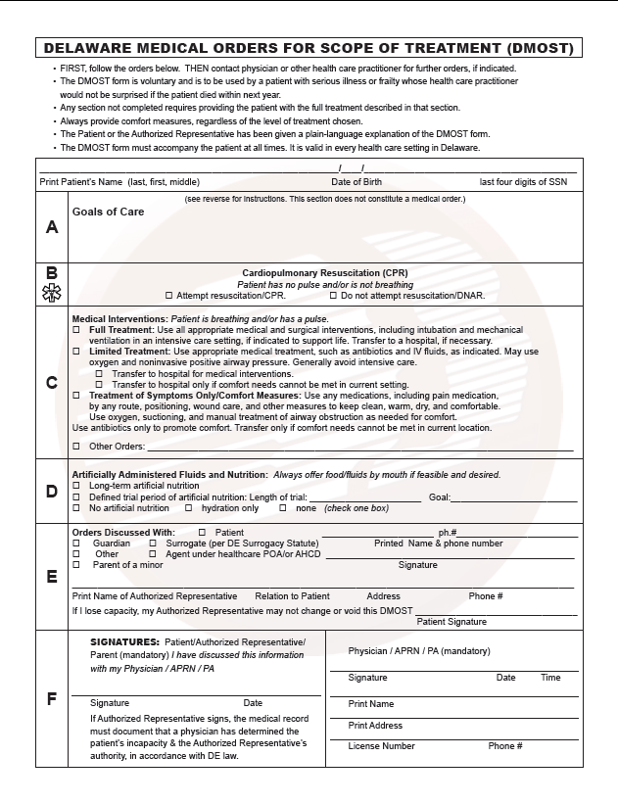

Slide 21
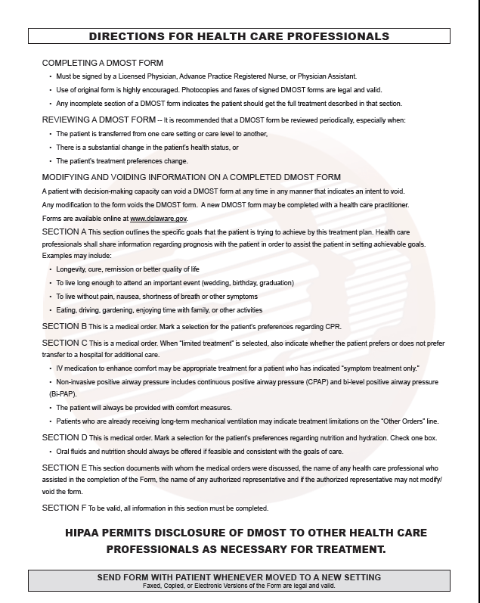

Slide 22
Creating a DMOST
Created in setting of serious illness with life expectancy of approximately 1 year.
Executed by person/and/or surrogate and HCP (physician/NP/PA)
Emphasis on the process of communication/conversation/decision making that fully informs and empowers for best result
Training on the process/conversation/form strongly encouraged
Notes:
The form can be downloaded from the website as mentioned.
Many of the larger health system EHR may have a direct link for this purpose. Once completed, it should have a place to live in the EHR and a copy should always be with the person in a pink envelope. ??
The HCP that executes DMOST may vary with circumstances.
One should aim for HCP that knows patient well
Try to complete at time of less stress and more mental clarity
One should encourage participation of surrogate decision maker/family even if pt has decisional capacity
Form can be introduced, facilitated by HCP other that the HCP that executes the order although the facilitator should be trained in the conversation/communication required.
Form can be completed to request all life sustaining treatment as well as to limit those treatments
One must pay attention to medical consistency with choices and indicate when time limited interventions are preferred.
Should be reviewed periodically and with any change in circumstance.

Slide 23
Honoring DMOST
Clear standardized form. Properly executed in a pink envelop.
Integrate process of recognition, honoring, storing in all health care settings.
EMS protocols
Admission process/converting to institutional equivalent (DNR/AND, etc) and GOC
EHR in all settings. Eventual registry
original to travel with the patient
Notes:
This form will be downloaded from the web site and printed in 2 sided fashion on regular paper. It will be stored in a pink envelop available? The bright color is to draw attention to it in an emergency situation.
Certain communities may also use DMOST stickers to alert EMS to the presence of the form.
EMS is on the front line for recognizing and honoring a DMOST
All health care settings will need to have a way of ackowledging and acting on a DMOST. It is recommended that a POLICY be developed to address this.
Best practice is to review and document any changes when condition/settings change.
There is an obligation to honor the form. It would be negligent to purposefully ignore the form with no documentation of why it was not followed. There are penalties for such at the felony level.
There is, however, limited immunity and room for clinical judgement.

Slide 24
The 8 Step DMOST Protocol*
Prepare for the discussion
Who, when, where?
2) Begin with what the patient and family know
3) Provide any new information about the patient's medical condition and prognosis from the medical team's perspective
4) Try to understand preferences. reconcile differences in terms of prognosis, goals, hopes and expectations
5) Respond empathically
6) Use DMOST to guide choices and finalize patient/family wishes
7) Complete and sign DMOST
8) Review and revise periodically
*adapted with permission from the work of Patricia Bomba, MD and Compassionandsupport.org
Notes:
Narrative: read off of bullet points
Parallels ask-tell-ask and Vital talk communication techniques
Checklist to ensure all appropriate items considered

Slide 25
DMOST Section A Goals of Care (Steps 6 and 7)
Notes:
Narrative: This slide represents an overall statement of goals of care for medical treatment and should guide the completion of the subsequent sections. It is not in and of itself a medical order.

Slide 26
DMOST Section B Cardiopulmonary Resuscitation (Step 7)
Notes:
This section is meant for clearly stating whether the person wants attempted resuscitation, and CPR or not, and is meant for patients in the context of full cardiac arrest when they have no pulse and are not breathing.

Slide 27
DMOST Section C Medical Interventions: (Step 7) Patient is breathing and/or has a pulse.
Notes:
Narrative: An option that should be discussed includes time limited interventions for more intensive medical treatments.
This slide indicates different levels of medical treatment from full treatment to symptom, or comfort focused treatment only.
-include information about the internal consistency of medical treatments outlined in sections B and C.

Slide 28
Diagram of interaction for sections B/C of DMOST
CPR
DNR
Full Treatment*
Selective Treatment
Comfort-Focused Treatment
*Consider time/prognosis factors under “Full Treatment”
“Trial Period of Full Treatment” may be checked if prolonged life support is not desired.
Notes:
This diagram points out a very important relationship between sections B and C.
Choosing “Attempt Resuscitation / CPR” in Section B requires choosing “Full Treatment” in Section C: Medical Interventions.
It is not acceptable to request “Attempt CPR” and “Selective Treatment” or “Comfort-Focused Treatment”.
If a person wants CPR, they must be willing to have ACLS (Advanced Cardiac Life Support) guidelines followed, which usually includes intubation and care in the ICU.
“Do Not Attempt Resuscitation / DNR” may be chosen with any of the Medical Interventions in DMOST Section C.
“DNR” may be chosen with “Full Treatment.” This applies to the patient who has a pulse and/or who is breathing and wants aggressive medical interventions, but who doesn’t want to be resuscitated if found without a pulse or not breathing (they have died).
It is important to address length of treatment, severity of illness, and prognosis with this option.
Ask the patient, “If you did not get better and doctors thought your chances of a good recovery were very poor, would you want to be kept alive on the ventilator?” If the patient does not want to be kept on prolonged life support, this can be recorded as a ‘time-limited trial’ in the other section.
Possible additional orders might relate to dialysis, chemotherapy, blood transfusions, or AICDs (automatic implantable cardioverter defibrillator). Note if patient has an AICD so it can be deactivated at the end-of-life.

Slide 29
Mr Hernandez
Time limited aggressive life support short of CPR
No long term life support

Slide 30
DMOST Section D Artificially Administered Fluids and Nutrition (Step 7)
Notes:
Narrative: This section refers to the artificially administered fluids and nutrition through an IV or tube. There is a section here for a defined time trial period that should be considered.

Slide 31
DMOST Section E Orders Discussed With: (Step 7)
Notes:
Narrative: This section clearly identifies the AR of the patient and also includes an opportunity for the patient to clearly prevent the ability of the AR to change the form after the patient has lost decisional capacity by placing their signature on the proper line

Slide 32
DMOST Section F Signatures and Physician, APRN, PA information (Step 7)
Notes:
Narrative: This section clearly identifies the signatories that will execute this this form including patient themselves and or AR, and the appropriate health care practitioner. Both of these signatures are mandatory for the form to be considered complete. The patient must sign first.

Slide 33
Mrs Clarkson
Clear choices/orders
Signed off by appropriate surrogate

Slide 34
What to Do with the Completed Form
Print, complete, sign, and put form in pink envelope which travels with the patient at all times
Request that someone adhere a pink “DMOST On File” sticker to front door, bedroom door, or to refrigerator.

Slide 35
Steps to Modify the Form
If revisions need to be made, the current form must be voided, and an entirely new form must be executed (step 8)
Notes:
Narrative: bullet on slide

Slide 36
Responding to The Form Across the Care Continuum
The form should travel with the person. Physically copying the form is discouraged.
The form may be scanned into an EMR. Use of a scanned document requires user to inquire about the existence of most recent version.
Healthcare settings are encouraged to develop DMOST policy to guide appropriate recognition, response and completion.
Notes:
Suggest best practices for recognizing, storing, honoring, and completing the form include:
Travel with person, copying the form is discouraged
Maybe scanned into an EMR. Use of a scanned document requires user to inquire about existence of more recent version.
Healthcare settings should develop DMOST policy to guide appropriate recognition/response.

Slide 37
Must be given to the patient as a part of the process leading to completion and execution of a DMOST form The health care provider facilitating completion or executing the form must be conversant with the content of the Plain Language FAQs so that they can speak with understanding and authority about their content with the patients and family for whom they were written.
The Plain Language FAQs

Slide 38
DMOST Checklist/CDF
Help document the process
Should be completed at time form is completed
Should travel with the form in the pink envelope
Documents special considerations for minors and persons with DD

Slide 39
Internet Resources
Delawaremost.org-authority for DMOST in First State
POLST.org

Slide 40
Discussion questions
How do I get DMOST forms and pink envelopes?
Who should do the training?
Who on the health care team should be responsible for executing a DMOST form with a patient/surrogate?
Is there reimbursement for this activity?
Notes:
CMS codes 99497
99498

Slide 41
Internet Resources
Delawaremost.org – authority resource for DMOST in the First State.
POLST.org
PREPAREforyourcare.org
Mydirectives.com
Coalitionccc.org
http://www.polst.org/educational- resources/legal-and-policy

